Slide 1
Hansen Creek Presentation
By: Alexandria Short

Slide 2
Presentation Overview
The following presentation will discuss Hansen Creek. The next photos show a map of the Hansen Creek area. This is followed by a satellite view of the area. Then, a map of the Skagit River and a map of the overall watershed, this is to point out the watershed area, drainage, and Hansen Creek’s connection to the Skagit River.
Next, I will discuss the species of fish in the area. Lastly, I will discuss the restoration project for the creek. I hope that you enjoy the presentation and Thank you for your time!

Slide 3
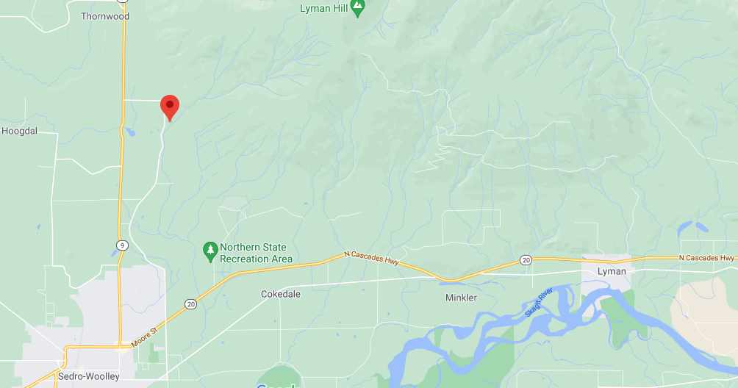
Hansen Creek map view

Slide 4
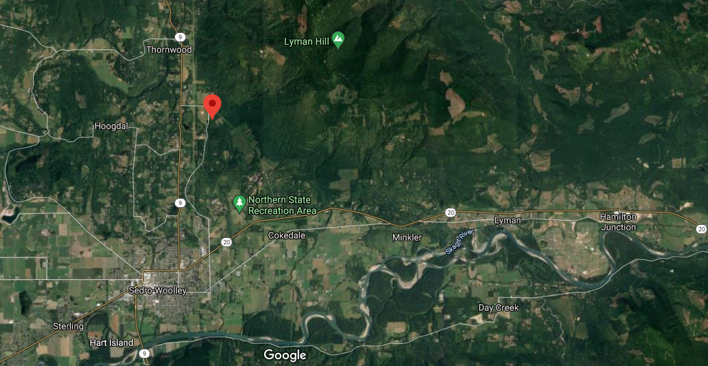
Hansen Creek Satalite view

Slide 5
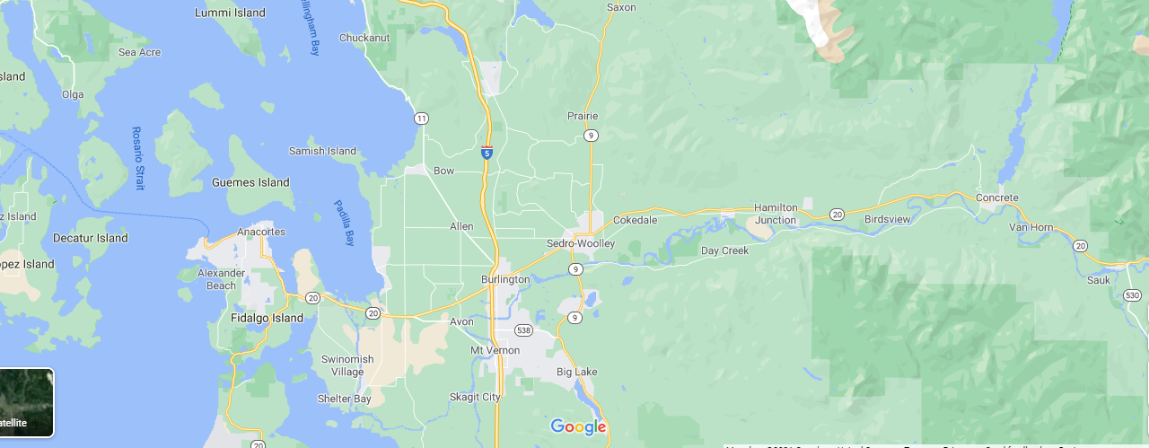
How it drains into Skagit

Slide 6
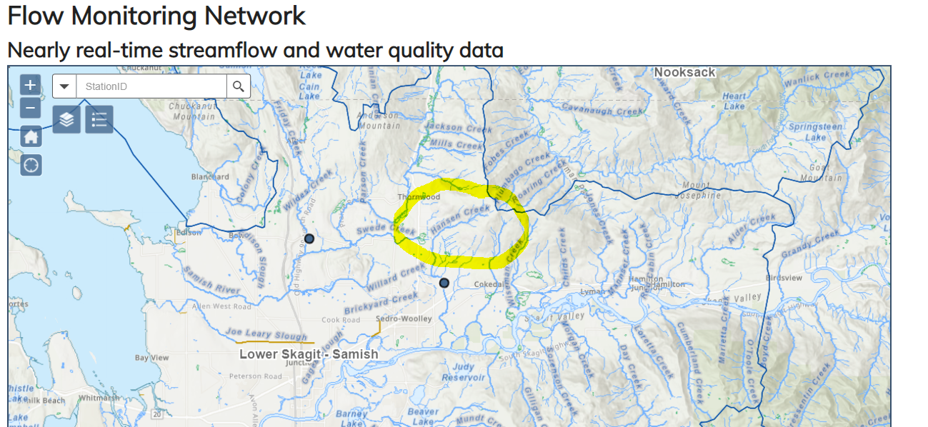
Watershed area and map
Notes:
https://apps.ecology.wa.gov/continuousflowandwq/IRPP?wria_ID=3

Slide 7
Fish Species
Hansen Creek is home to Chinook, Chum, Coho and Pink salmon, and it is also a habitat for Steelhead and Cutthroat trout. The stream provides an excellent place for salmon spawning. Salmon population restoration is a major goal of the restoration project.

Slide 8
Stream restoration
The main idea of the stream restoration is to develop a recreational area and work to improve the condition of the salmon habitat. The goal is also to reduce flooding in the area. The restoration summary is on the next slide.

Slide 9
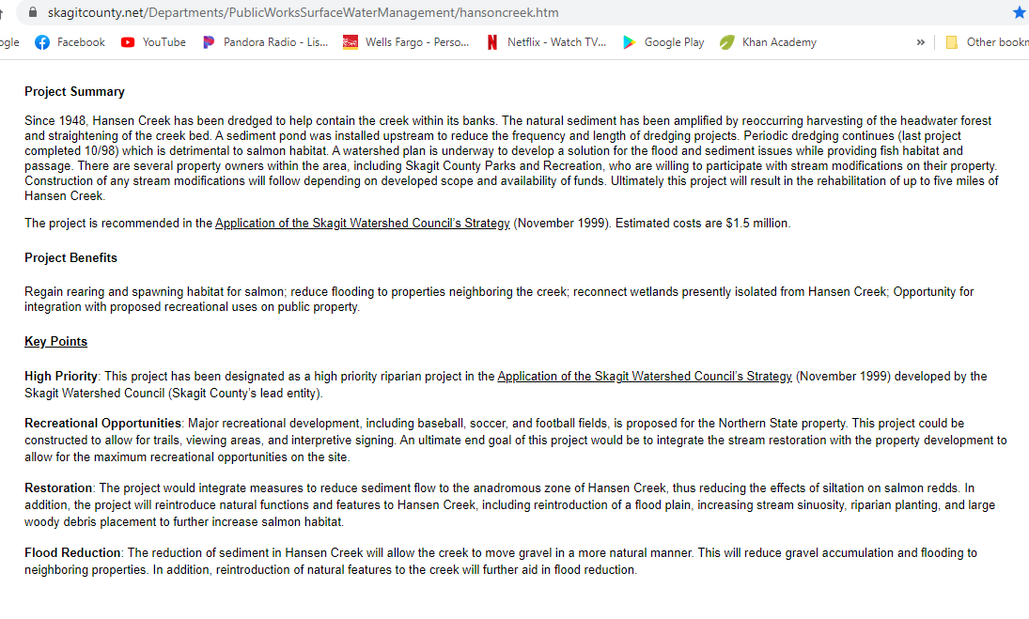
Notes:
https://www.skagitcounty.net/Departments/PublicWorksSurfaceWaterManagement/hansoncreek.htm

Slide 10
Sources
Map images are from google maps,
Watershed map area https://apps.ecology.wa.gov/continuousflowandwq/IRPP?wria_ID=3
Stream restoration summary https://www.skagitcounty.net/Departments/PublicWorksSurfaceWaterManagement/hansoncreek.htm
Thank You!

